Slide 1
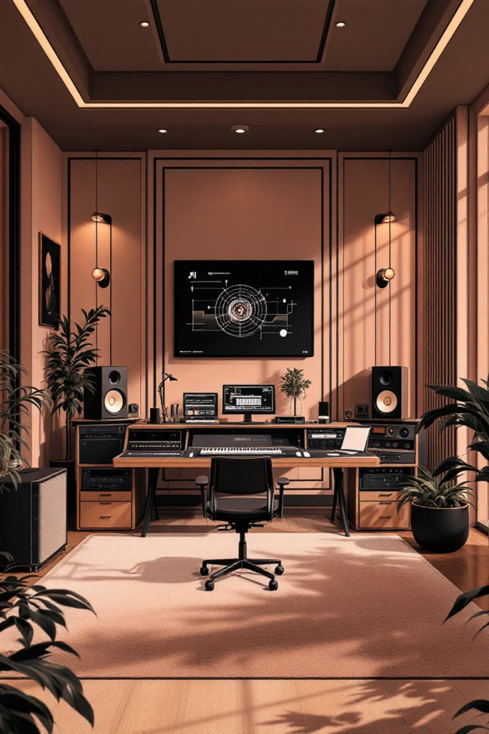
Mood Music AI
Transforming Emotions into Music with AI
An intelligent system for emotion-based music composition that empowers creators to generate personalized soundtracks instantly.

Slide 2

The Creative Challenge
Time-Consuming
Searching through vast music libraries for the perfect track can take hours of valuable creative time.
Subjective & Inconsistent
Keywords like "happy" yield thousands of results that rarely match your specific creative intent.
Costly Licensing
High-quality tracks come with expensive licensing fees, especially for commercial projects.
Lack of Uniqueness
Stock music is used by thousands, making it impossible to create a distinctive sound for your project.

Slide 3
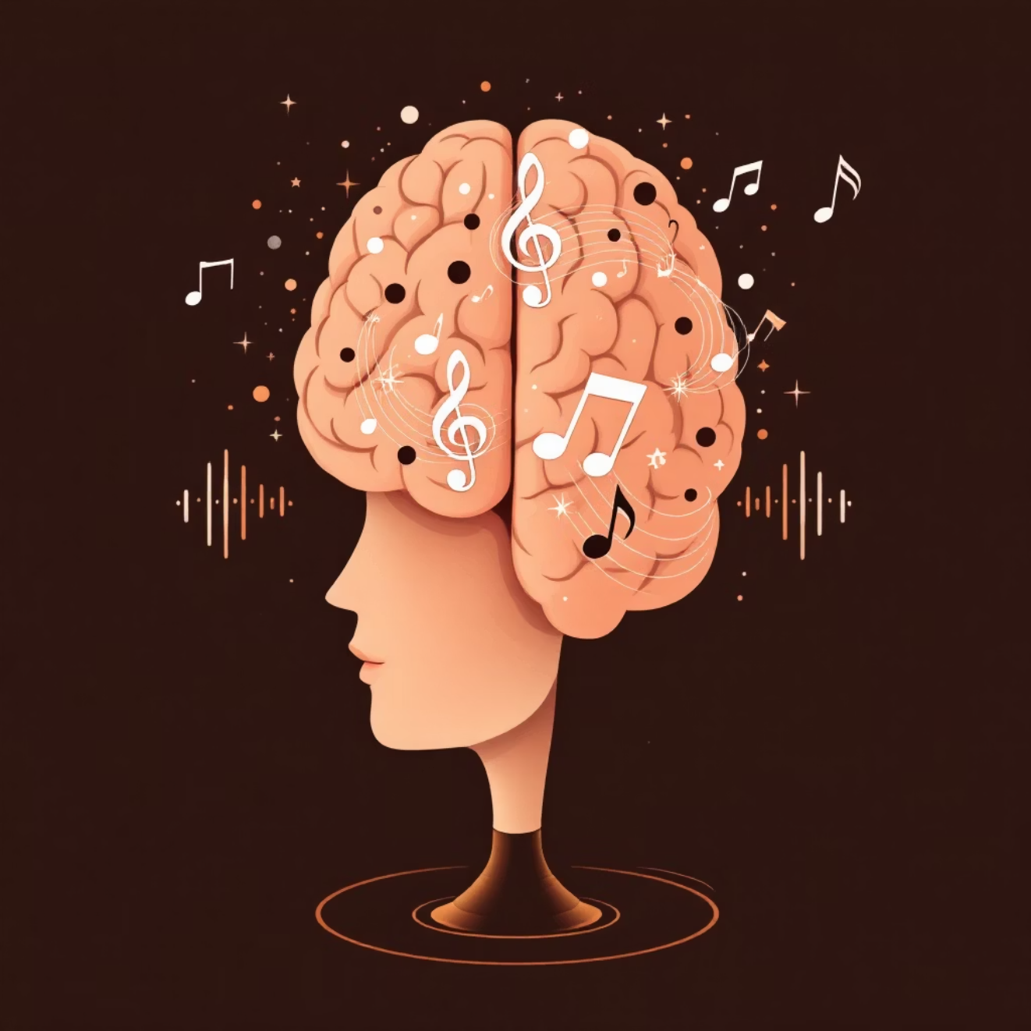
The Solution
AI-Powered Music Generation
Mood Music AI revolutionizes music creation by allowing users to generate high-quality, original music simply by describing their emotions in plain text.
This breakthrough technology empowers anyone—regardless of musical ability—to create personalized soundtracks on demand, providing a powerful tool for creative professionals and casual users alike.
"Transform your feelings into melodies with the power of artificial intelligence."

Slide 4



How It Works: Three Simple Steps
Text Input & Mood Analysis
Users describe their feelings in natural language. Advanced NLP models analyze the text to accurately classify the core emotional state.
AI Parameter Generation
The system intelligently generates detailed musical parameters including genre, tempo, key, chord progression, and instrumentation.
Music Generation & Mastering
Parameters create a hyper-descriptive prompt for MusicGen AI, followed by automated audio mastering for professional quality.

Slide 5
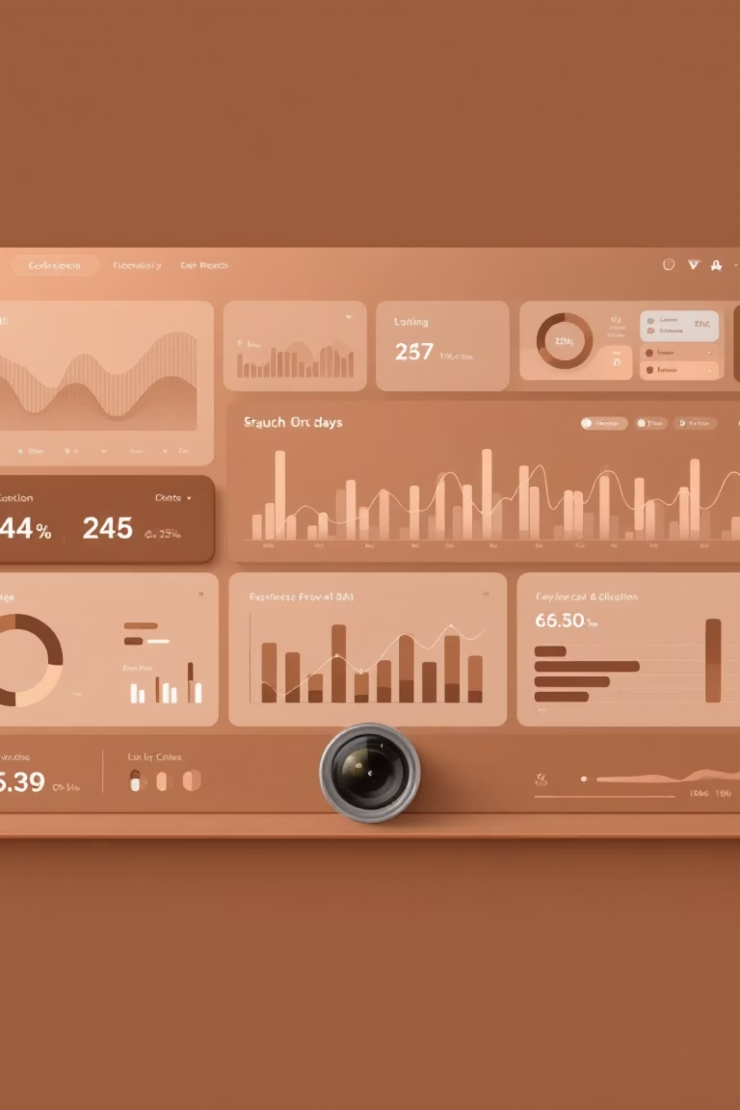



Advanced Technology Stack
High-Accuracy Mood Detection
State-of-the-art Zero-Shot Classification model interprets a wide range of emotional inputs with precision.
Advanced Prompt Engineering
Goes beyond simple keywords to create rich, descriptive prompts that generate exceptional AI results.
Real-Time Audio Mastering
Custom-built post-processing pipeline applies noise reduction and stereo expansion for fuller, clearer sound.

Slide 6
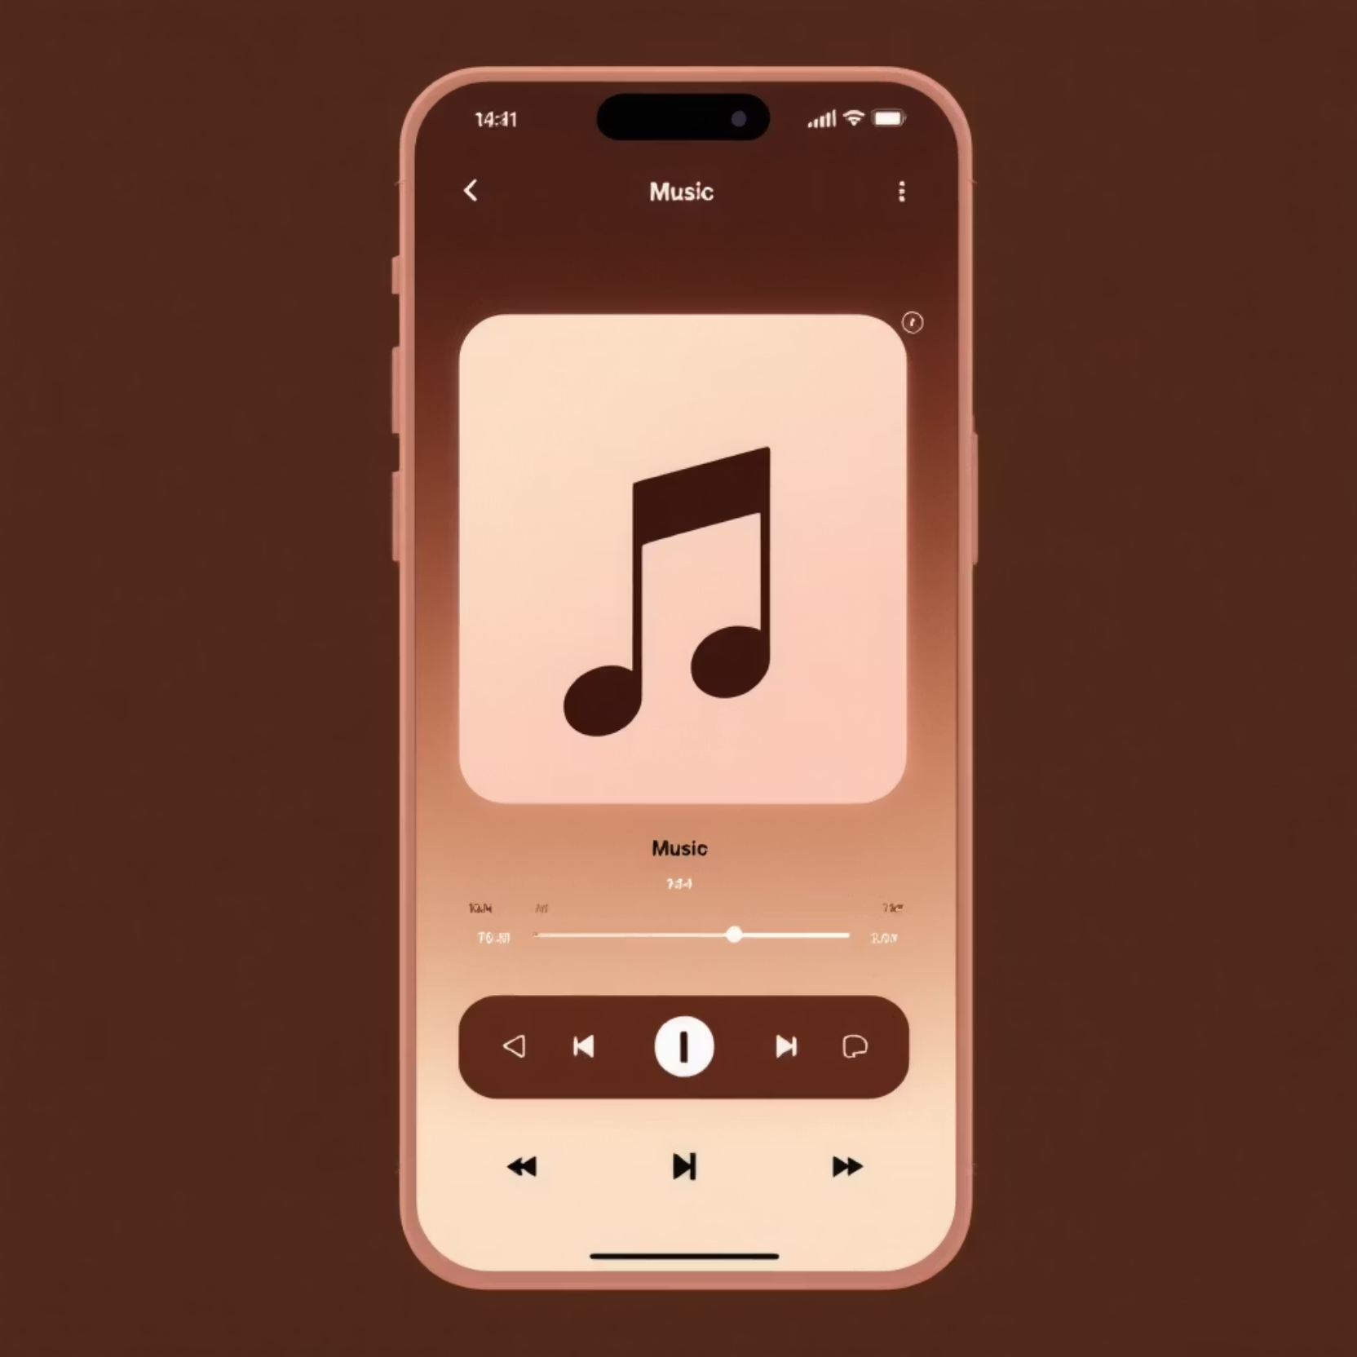
User Experience Excellence
Intuitive Interface
A modern, responsive interface built with React.js and styled with Tailwind CSS, ensuring a fast and seamless user experience.
Visual Feedback
Real-time waveform visualization lets users see their generated music come to life.
Complete User System
Full authentication with login and history features, using a secure SQLite database for users to save and revisit their musical creations.

Slide 7

Core Technologies
Frontend: React.js & Vite
The user interface is built on a modern frontend stack including React.js for a dynamic user experience, Tailwind CSS for styling, and is powered by Vite for optimal performance.
Backend & AI: Python & Transformers
The core audio processing and AI logic are handled by Python, utilizing libraries like PyTorch, Pydub, and Librosa. The Transformers framework provides cutting-edge NLP capabilities for emotion detection.
AI Models
Facebook's BART-large-mnli for mood classification and MusicGen-small for high-quality music generation.

Slide 8








Market Impact & Applications
Professional Use
Content Creation
Enhance presentations, marketing materials, and corporate communications with custom music.
Perfect soundtracks for videos, podcasts, and social media content without licensing concerns.
Gaming & Interactive Media
Therapeutic Applications
Personalized music therapy and wellness applications for mental health support.
Dynamic background music that adapts to gameplay emotions and narrative moments.

Slide 9





The Future of AI-Powered Creativity
Key Benefits
Democratizing Music Creation
Creative Assistance
Zero musical training required
Breaking down barriers between musical expertise and creative expression, making professional-quality composition accessible to everyone.
Serving as a powerful collaborative tool for musicians, helping overcome creative blocks and sparking new artistic directions.
Instant professional results
Royalty-free compositions
Unlimited creative possibilities
Ethical Innovation
Addressing important questions of copyright, ownership, and the responsible integration of AI in creative industries.

Slide 10
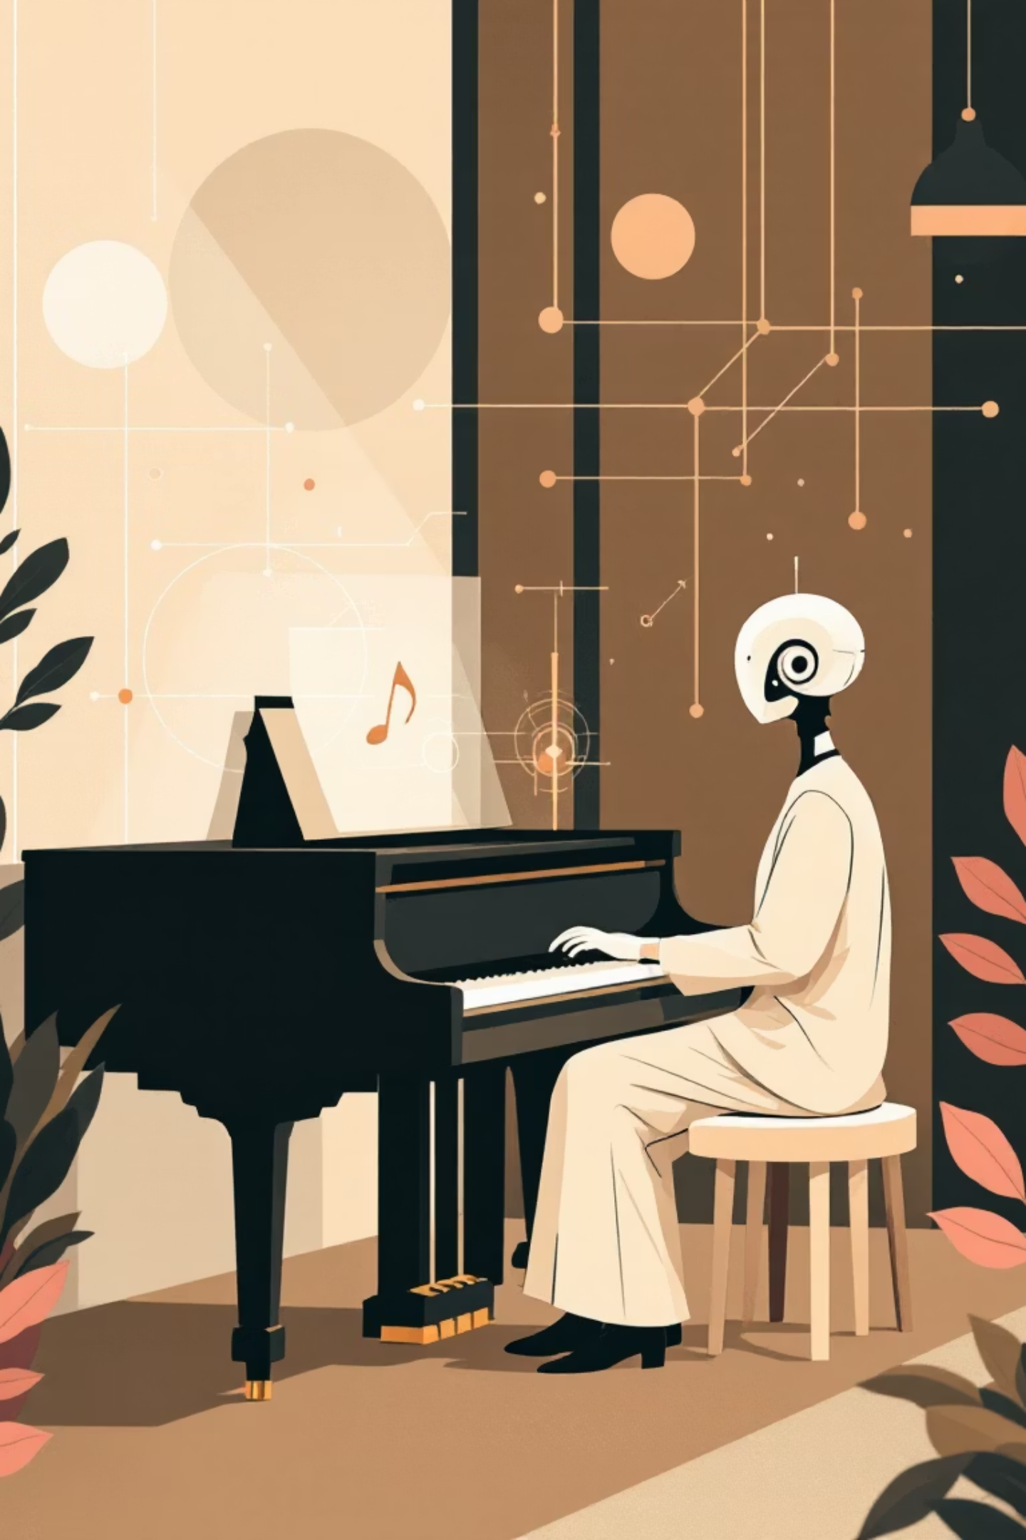
Ready to Transform
Your Creative Process?
Mood Music AI represents the future of creative technology—where human emotion meets artificial intelligence to produce something truly magical.
Instant Creation
Professional Quality
Limitless Possibilities
From concept to composition in seconds
AI-mastered tracks ready for any project
Every emotion has its perfect soundtrack

Slide 11
THANK YOU

